Slide 1
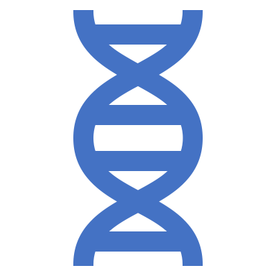
Genetic Algorithm
Presented By:
Dipesh Paudel (16/077)
Madan Bhandari (18/077)

Slide 2
Table of Content
Genetic Algorithm Introduction
Data Structures Used in GA
Reproduction
Crossover
Mutation

Slide 3
GA Introduction
Search algorithms based on the mechanics of biological evolution.
Developed by John Holland, University of Michigan
To understand the adaptive process of natural systems
To design artificial systems software that retains the robustness of natural systems.
Can be used for finding solutions of:
Searching problem
Optimization problem

Slide 4
Data Structures
Population
Chromosomes
Gene
Allele
Genotype
Phenotype
Encoding
Decoding
Fitness Function

Slide 5
Population
Subset of solution set
Solution set – All possible solution member
Also known as candidate solution
Collection of chromosomes

Slide 6
Chromosomes
Individual solution to the given problem
Typically encoded as a string or an array of genes.

Slide 7
Gene
One element position of a chromosome.
Each gene corresponds to a specific parameter or component of the solution.
The arrangement of genes within a chromosome forms the candidate solution.

Slide 8
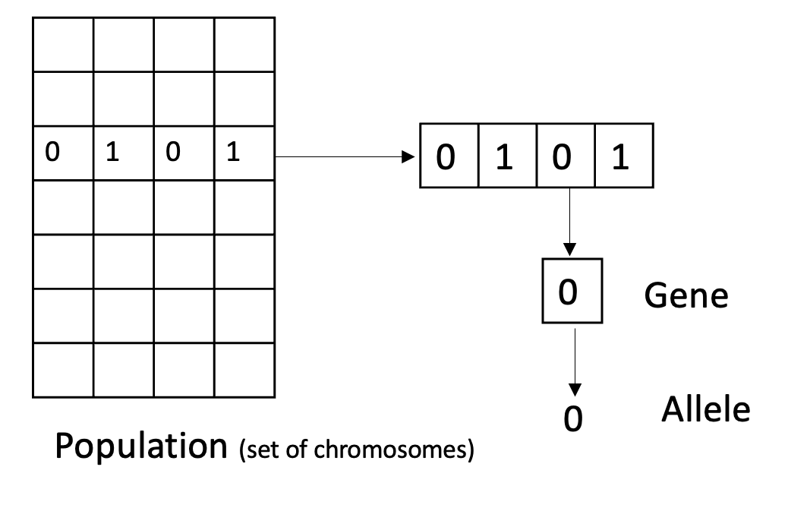
Allele
The positional value of gene

Slide 9
Genotype
Mathematical representation format
Computation space
Encoding of phenotype solutions

Slide 10
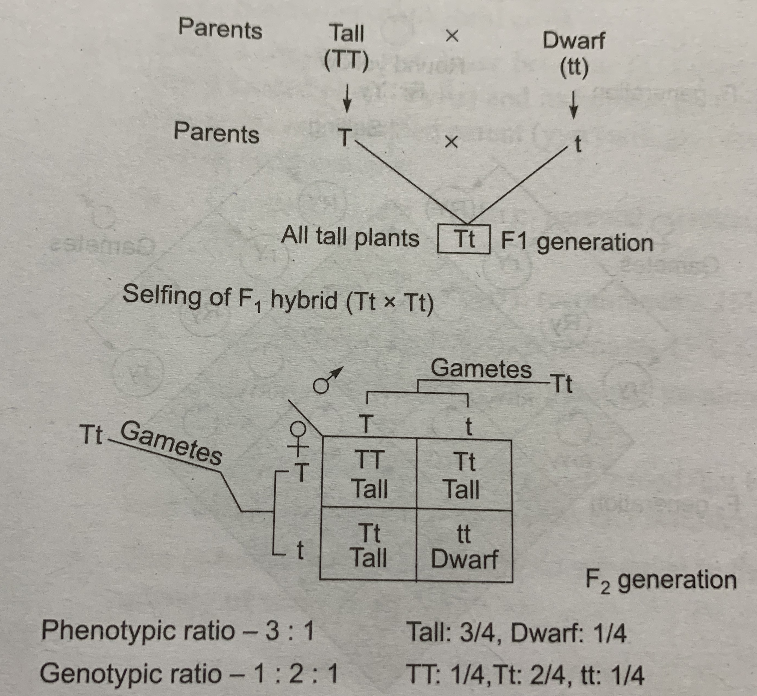
Phenotype
How actually it looks like in nature.

Slide 11
Encoding
Genotype
Encoding
Phenotype
Conversion of solution set from Phenotype to Genotype.
It can be: (Genotype Representation)
Binary representation
Boolean 0(absent) or 1(Present) used
Real value representation
Using the actual value of gene (Floating point value)
Integer representation
Integer (whole number) used for representation
Permutation
Positional Significance – e.g. TSP

Slide 12
Decoding
Reverse of Encoding
i.e. Conversion from genotype to phenotype.
Genotype
Decoding
Phenotype

Slide 13
Fitness Function
Function used to determine how fit a particular chromosome is.
How fit the chromosome is toward the optimal solution?

Slide 14
Genetic Operators(3 Types)
Reproduction
Crossover
Mutation

Slide 15
Population initialization
Fitness function Calculation
Crossover
Repeat Until Termination
Mutation
Survivor Selection
Terminate and Return Best
Fig: Genetic Operators in GA

Slide 16
Reproduction
Selecting parent chromosomes from the current population to create offspring for the next generation.
The probability of selection is based on the fitness of each chromosome.
Fitter chromosomes having a higher chance of being selected.

Slide 17
Reproduction
Selection of parent for reproduction can be done using any of following:
Roulette Wheel Selection
Stochastic Universal Smapling (SUS)
Tournament Selection
Rank Selection

Slide 18
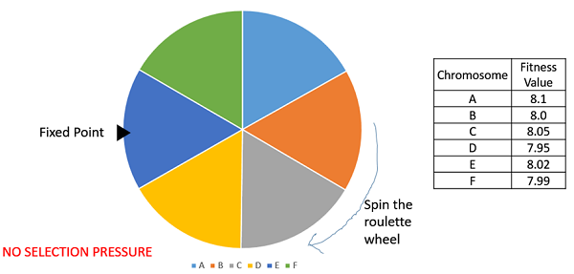
Roulette Wheel Selection

Slide 19
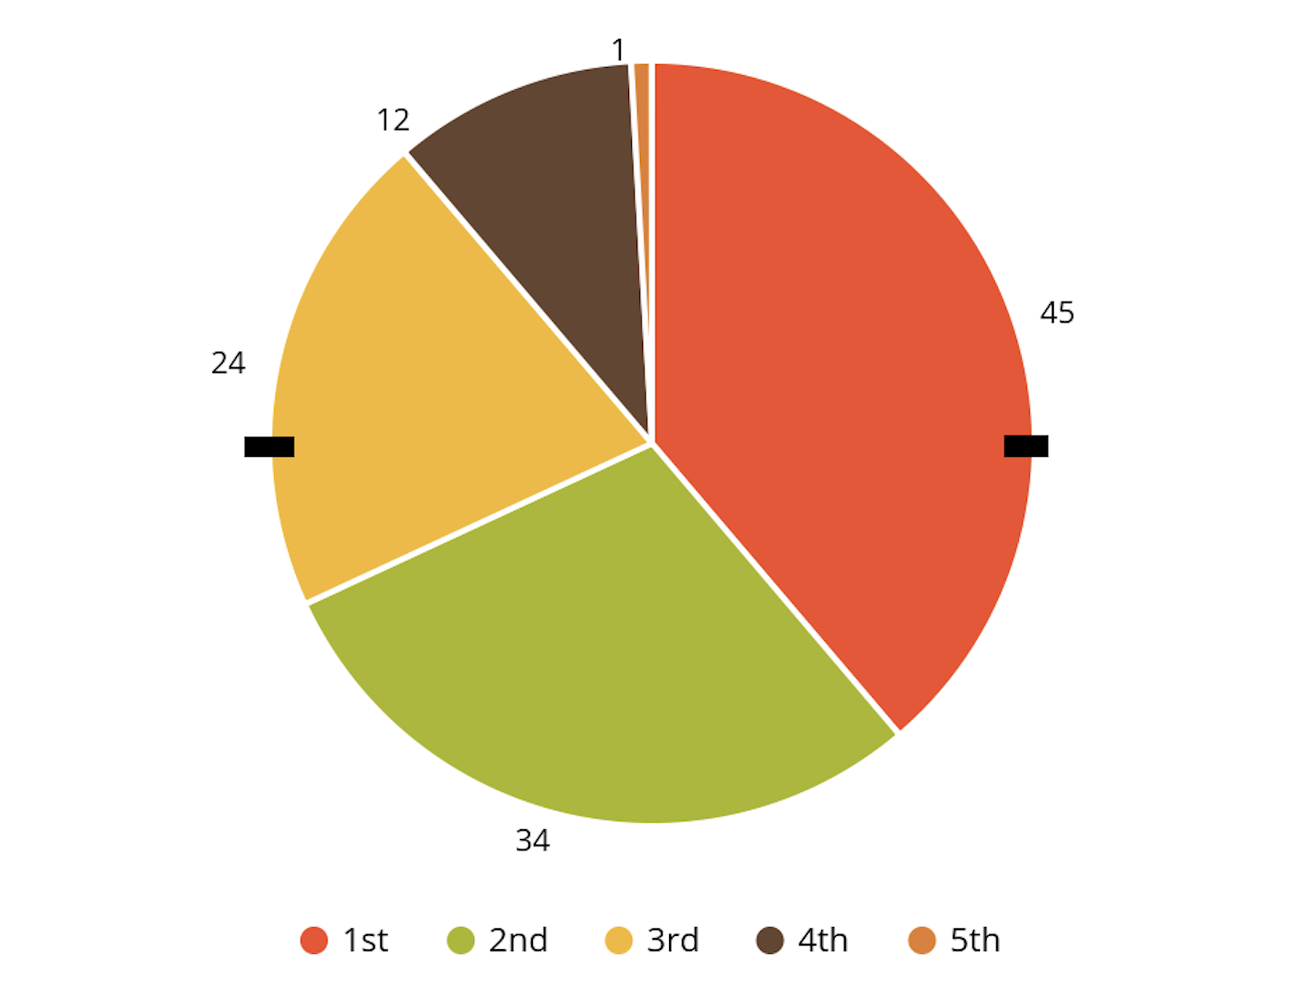
Stochastic Universal Sampling (SUS)
Same as Roulette wheel selection
We take two fixed point.

Slide 20
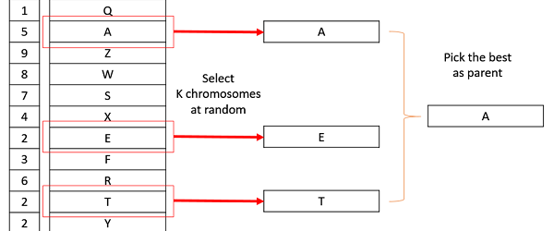
Tournament Selection

Slide 21
Rank Selection
Chromosome | Fitness | Rank
1 | 6 | 2
2 | 9 | 1
3 | -2 | 6
4 | 0 | 5
5 | 4 | 3
6 | 1 | 4
(-ve) fitness can also be selected.
Parent selected, based on the rank.

Slide 22
Crossover
Combining two parent chromosomes to create offspring chromosomes.
Types:
One-point Crossover
Davis' Order Crossover (OX1)
Cyclic Crossover (CX)
Partially Matched Crossover (PMX)

Slide 23
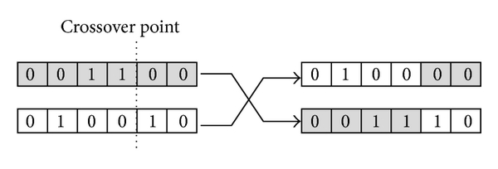
One-point Crossover

Slide 24
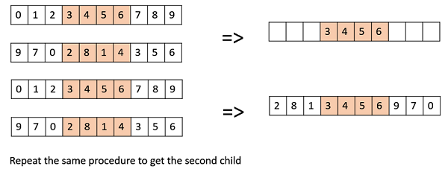
Davis’ Order Crossover (OX1)
Used for permutation based crossovers
Notes:
Create two random crossover points in the parent and copy the segment between them from the first parent to the first offspring.
Now, starting from the second crossover point in the second parent, copy the remaining unused numbers from the second parent to the first child, wrapping around the list.
Repeat for the second child with the parent’s role reversed.

Slide 25
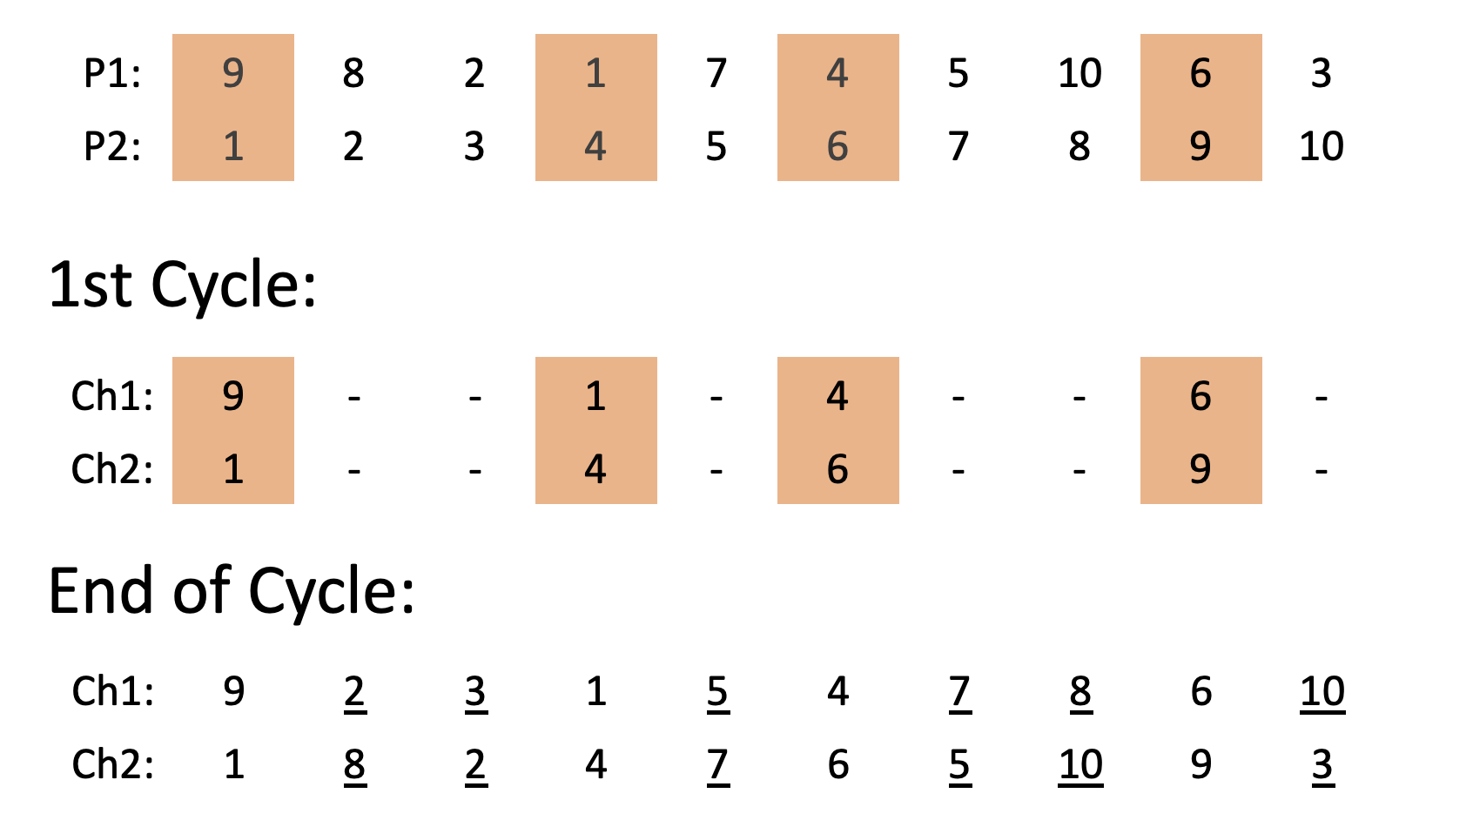
Cyclic Crossover (CX)

Slide 26
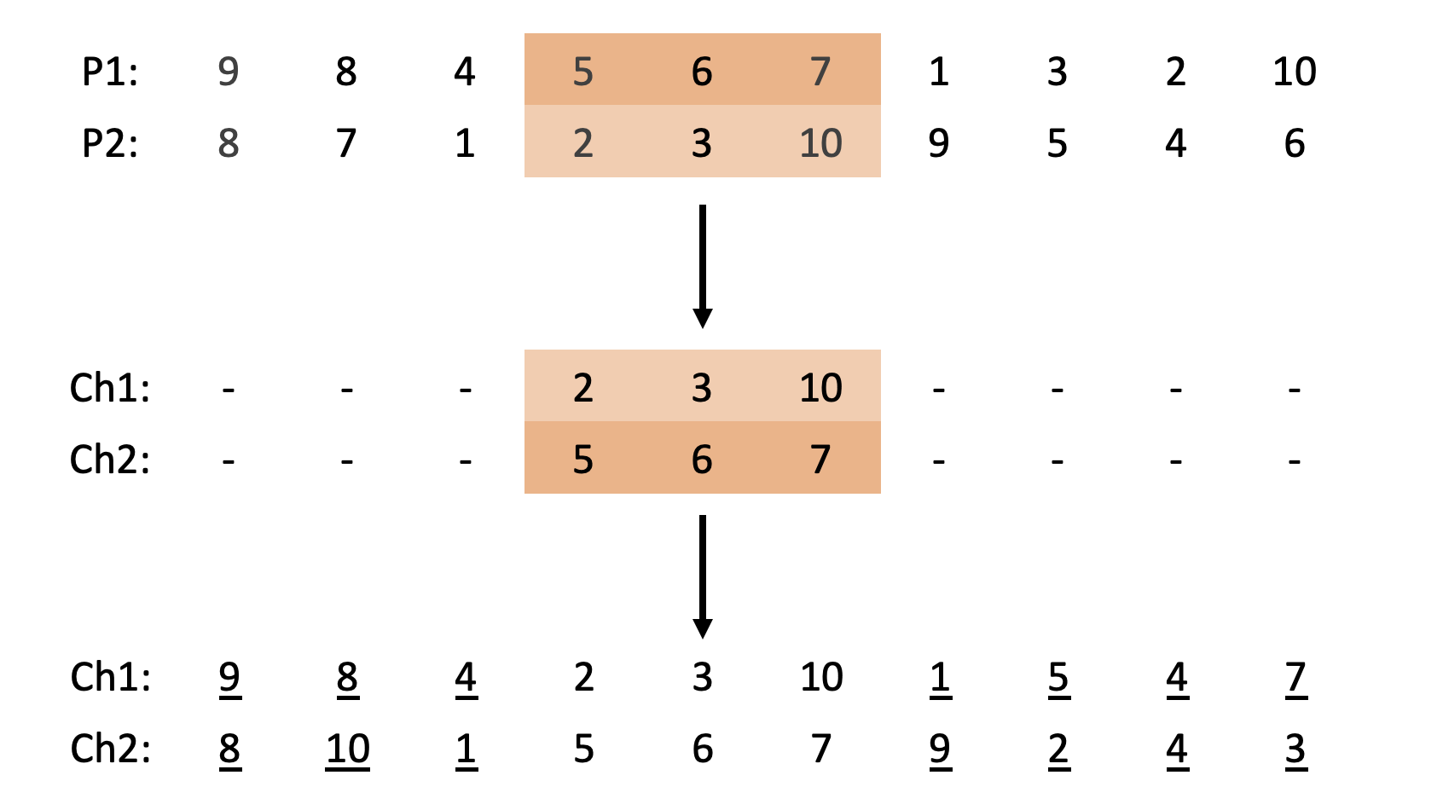
Partially Matched Crossover(PMX)

Slide 27
Mutation
Small random tweak in the chromosome to get new solution
Types:
Bit flip mutation
Random resetting
Swap mutation
Scramble mutation
Inversion mutation

Slide 28
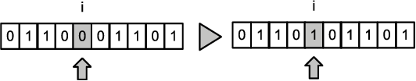
Bit flip mutation
Select one or more bits and flip them.
Used for binary encoded GAs.

Slide 29

Random resetting
Extension of the bit flip for the integer representation.
A random value from the set of permissible values is assigned to a randomly chosen gene.

Slide 30
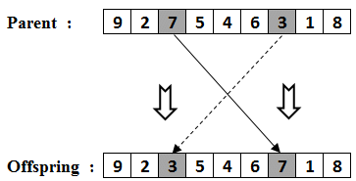
Swap mutation
Select two positions on the chromosome at random and interchange the values.

Slide 31
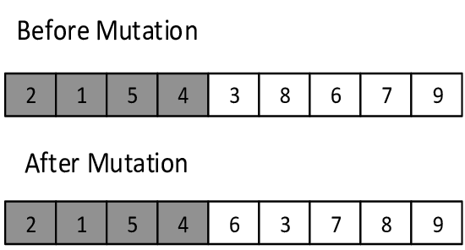
Scramble mutation
From the entire chromosome, a subset of genes is chosen, and their values are scrambled or shuffled randomly.
popular with permutation representations.

Slide 32
Inversion mutation
Select a subset of genes like in scramble mutation
But instead of shuffling the subset, we merely invert the entire string in the subset.

Slide 33

Thank You !!!

